Slide 1
How to setup your testing environment, the DevOps way
Viorel Ciucu
@viorelciucu

Slide 2


Get-Identity
Consultant, Automator, Database Administrator, SRE
VCI Consulting
vciconsulting.net
linkedin.com/in/cviorel
twitter.com/viorelciucu

Slide 3
AGENDA
DevOps way of deploying infrastructure - SQL Server Availability group
Use cases:
Test Labs
Demos
New real-world environments (DEV/QA/STAGE/PROD)

Slide 4
WHY?
Consistency across environments
Continuously improve
Compliance
Automation ensures processes are followed

Slide 5
Get-Prerequisite
PowerShell
Active Directory
VM Templates

Slide 6

Get-Resources
https://github.com/cviorel/Presentations/tree/main/2021/new_stars_of_data

Slide 7
Get-Tools
Packer - https://www.packer.io
Terraform - https://www.terraform.io
DBATools - https://dbatools.io

Slide 8
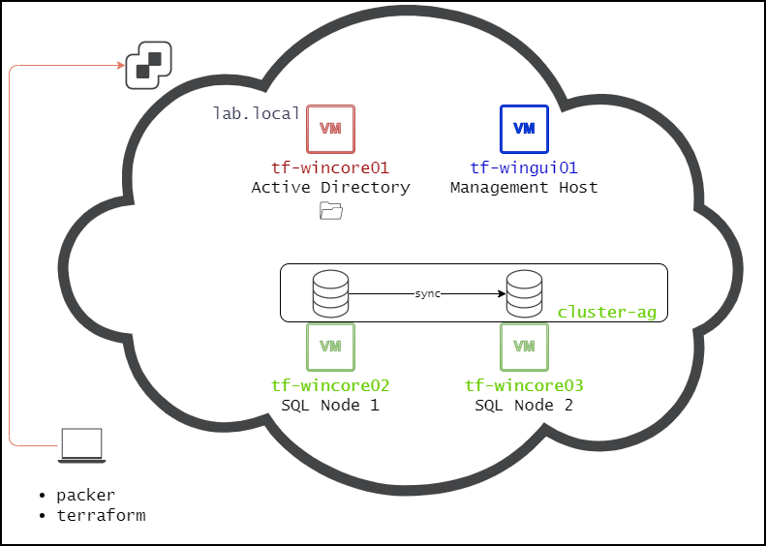
New-Infra

Slide 9
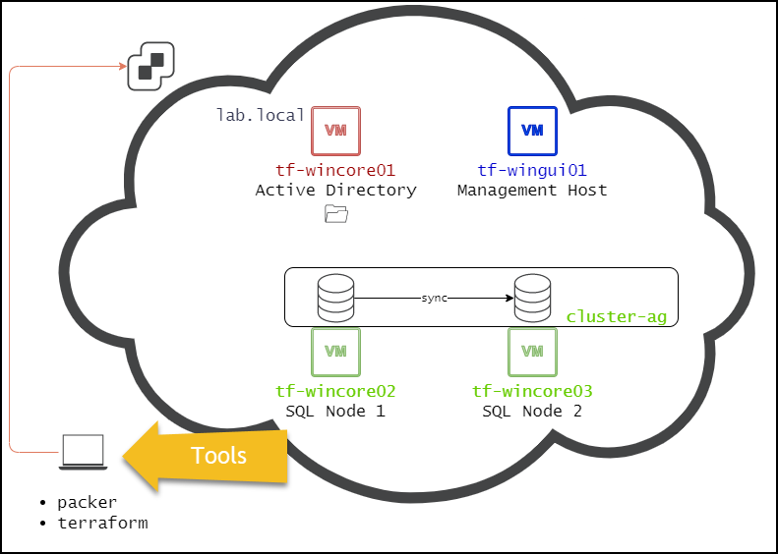
New-Infra

Slide 10
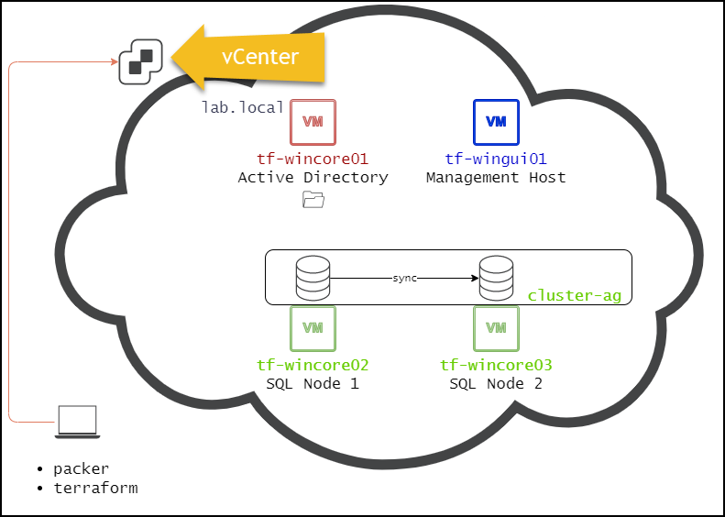
New-Infra

Slide 11
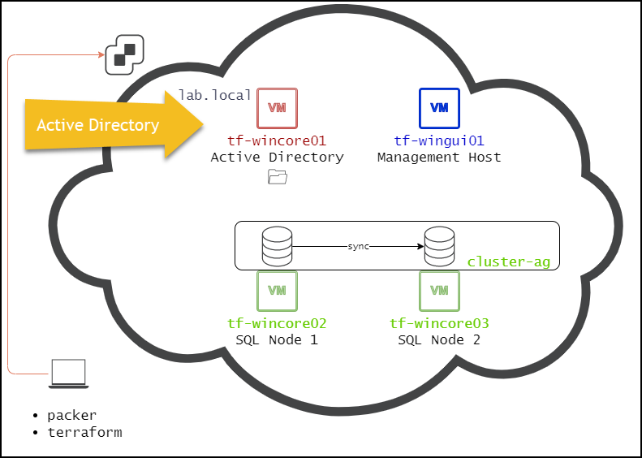
New-Infra

Slide 12
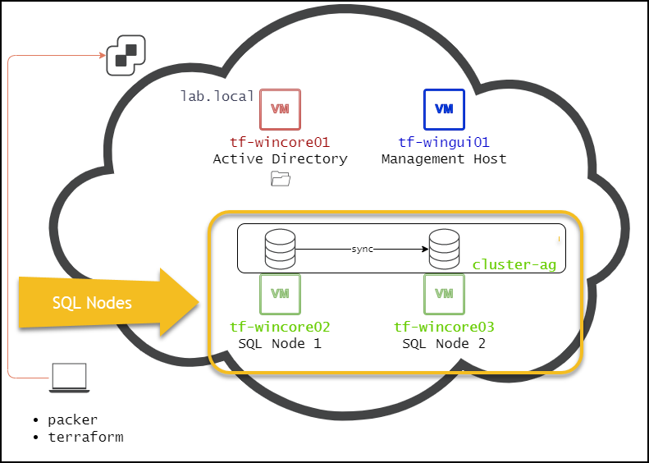
New-Infra

Slide 13
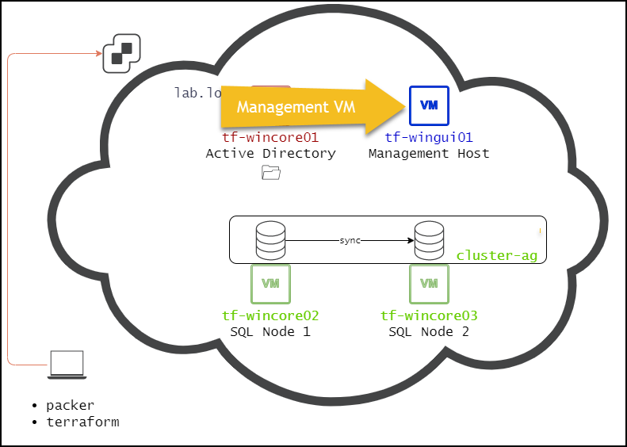
New-Infra

Slide 14
Packer
I need templates!
Automate it!

Slide 15
Packer
Packer automates the creation of machine images

Slide 16
Builders
Builders are responsible for creating machines and generating images from them for various platforms.
Separate builders for EC2, VMware, VirtualBox, Azure, etc.

Slide 17
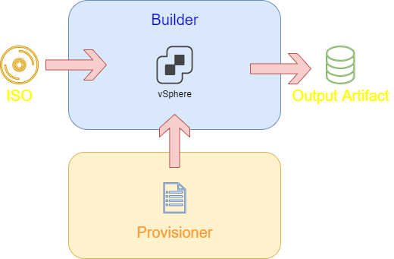
Packer
packer build -force -var-file='json\vars.json' 'json\win2019core.json'

Slide 18
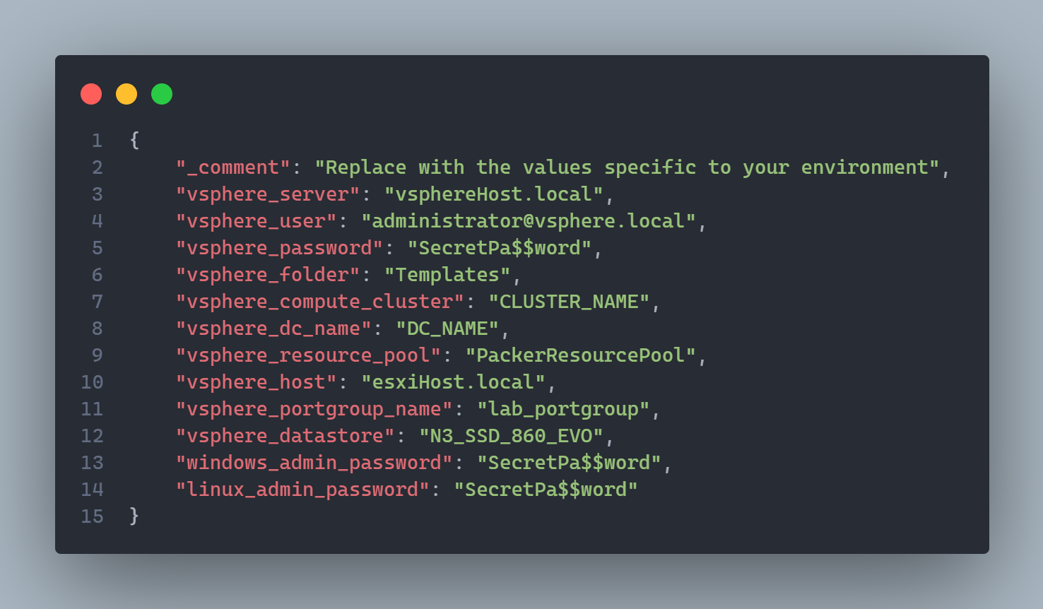
Variables

Slide 19
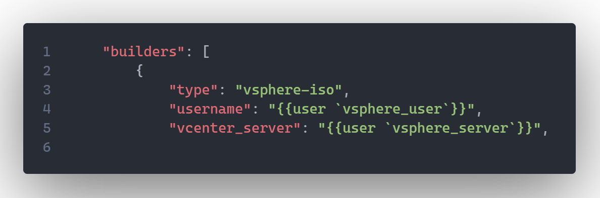
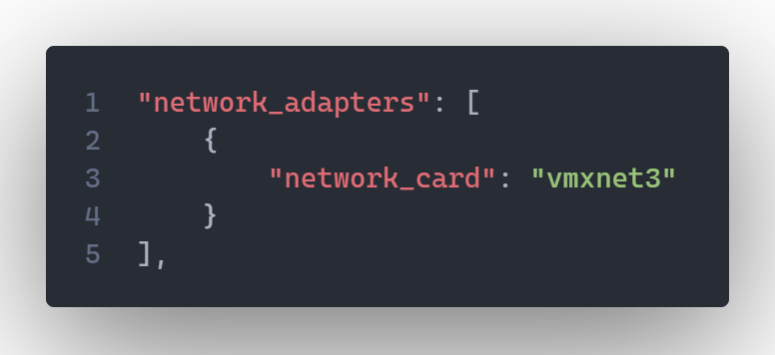
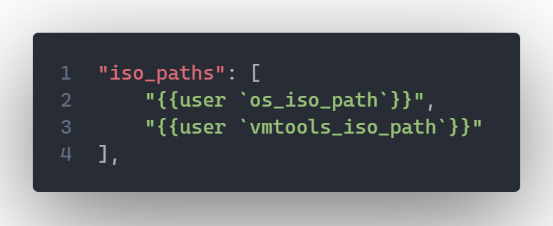
Builders

Slide 20
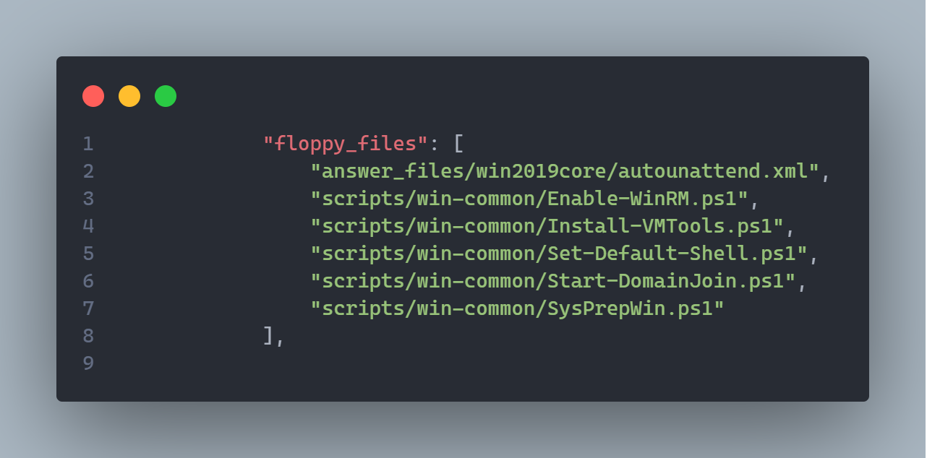
Packer

Slide 21
PACKER DEMO

Slide 22


Slide 23
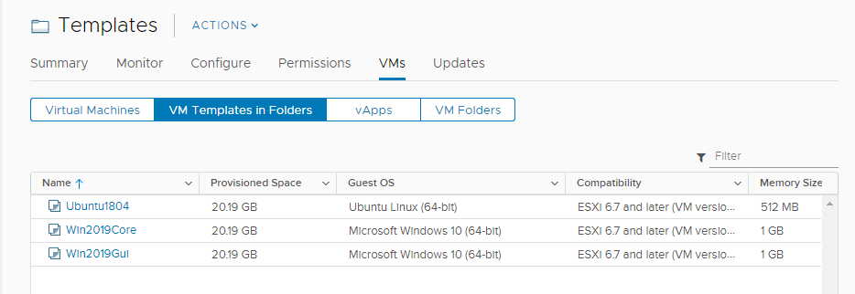
Packer

Slide 24
Terraform
Deploy VMs from the templates
Automate it!

Slide 25
Terraform
build, change and version infrastructure safely and efficiently - Infrastructure as Code (IaC)
provision entire infrastructures that span across multiple public and private cloud providers
manages external resources (network appliances, software as a service, platform as a service, etc.)

Slide 26
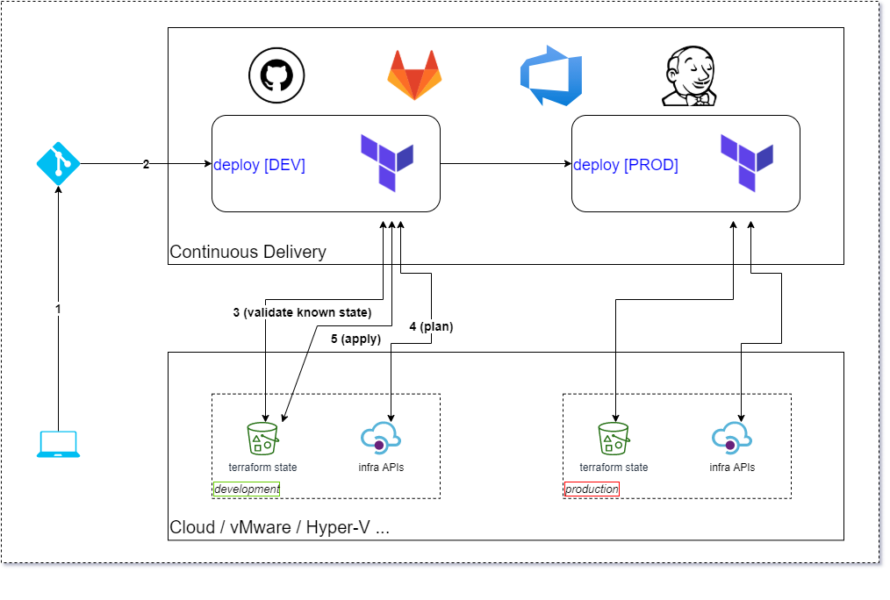
Terraform

Slide 27
Terraform
The syntax of Terraform configurations is called HashiCorp Configuration Language (HCL)

Slide 28
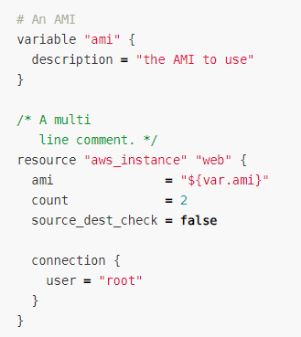
Terraform

Slide 29
Terraform
Terraform relies on plugins called "providers“ to interact with remote systems

Slide 30
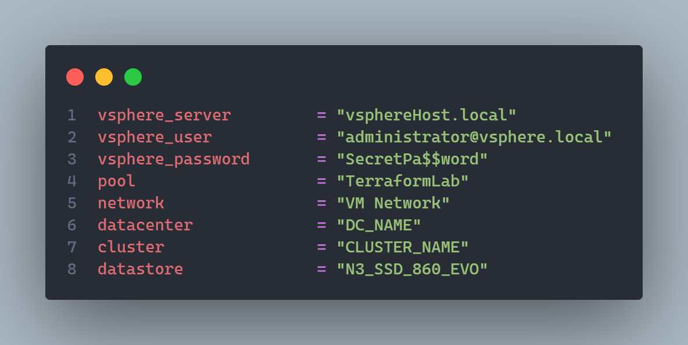
Terraform

Slide 31
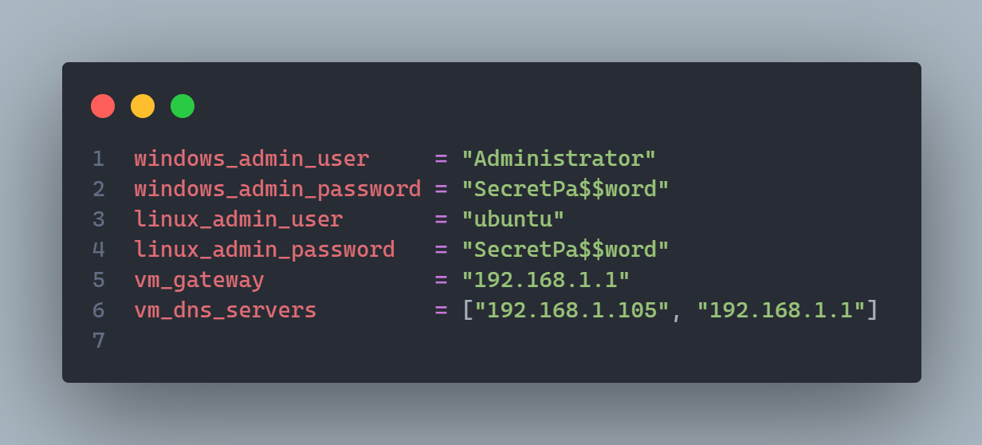
Terraform

Slide 32
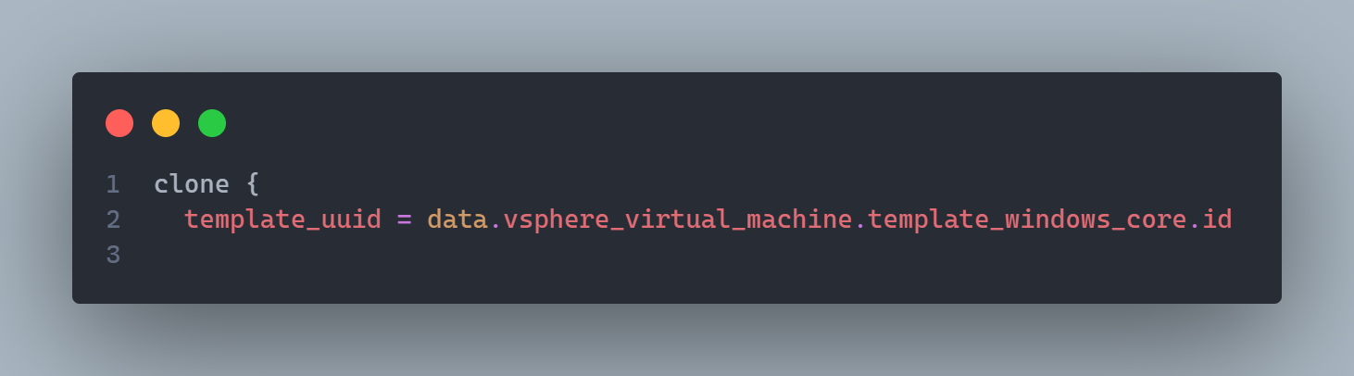
Terraform

Slide 33
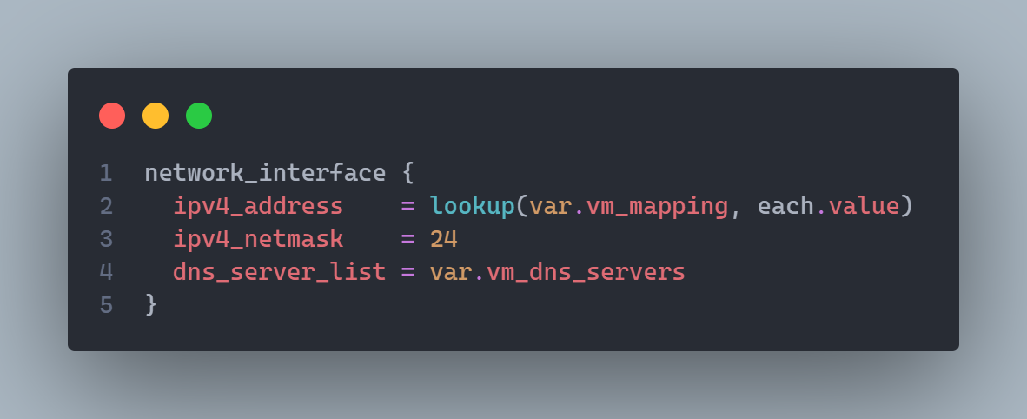
Terraform

Slide 34
Get-Code
Let’s see the code!

Slide 35
Terraform
terraform plan - creates an execution plan

Slide 36
Terraform
terraform apply - applies the changes required to reach the desired state

Slide 37
TERRAFORM DEMO

Slide 38


Slide 39
Deploy the LAB

Slide 41
Start-Build
Build an Active Directory
Join the computers to the AD

Slide 42
Start-Build
Create gMSAs
Install SQL instances
Configure SQL instances

Slide 43
Start-Build
Create WFC
Create an Availability Group

Slide 44
Set-Variables
00_set-variables.ps1

Slide 45
Set-Variables
dot sourcing 00_set-variables.ps1
. .\00_set-variables.ps1

Slide 46
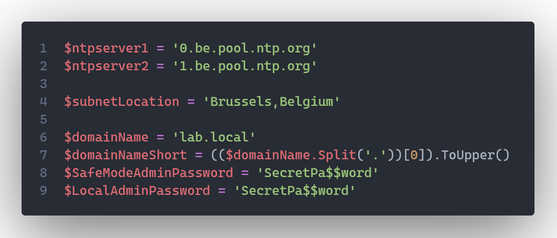
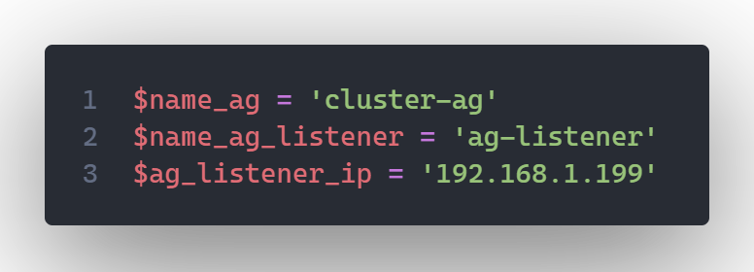
Variables
Domain controller – name and IP
SQL Nodes – name and IP
NTP Servers
Cluster Name & IP
SQL Instance Name and TCP Port
Collation
SQL Folder Names
AG Name
AG Listener Name & IP

Slide 47
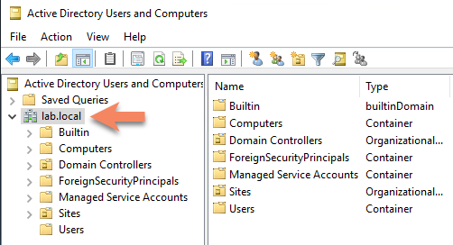
Setup AD
Create forest
Add DNS Zones
Configure DNS Scavenging
Configure NTP
KdsRootKey

Slide 48
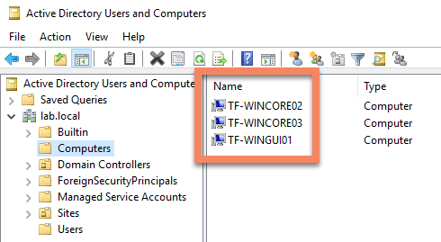
Domain join

Slide 49
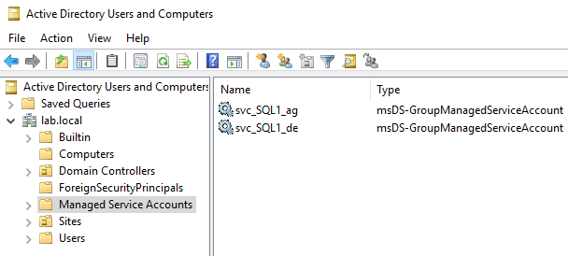
gMSA

Slide 50
Start-Configuration
Configuration management tools:
Puppet
Ansible
Chef

Slide 51
dbatools

Slide 52
dbatools
PowerShell module with over 500 SQL Server administration, best practice and migration commands included - dbatools.io

Slide 53
Get-Tasks
Install SQL Server on the 2 nodes
Configure SQL Server instances
Perform hardening (NTFS permissions, revoke connect to guest, etc.)
Install Ola Hallengren’s Maintenance Solution
Install WhoIsActive
Create SQL Agent Jobs and Schedules
Create a new TestDB database
Create an Availability Group
Create an Availability Group Listener
Verify SPNs

Slide 54
Install SQL Server on the 2 nodes
Configure SQL Server instances
Perform hardening (NTFS permissions, revoke connect to guest, etc.)
Install Ola Hallengren’s Maintenance Solution
Install WhoIsActive
Create SQL Agent Jobs and Schedules
Create a new TestDB database
Create an Availability Group
Create an Availability Group Listener
Verify SPNs

Slide 55
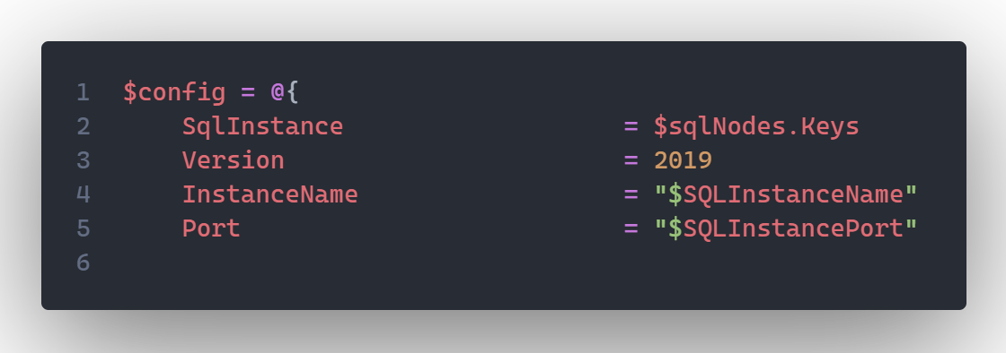
Install SQL Server

Slide 56
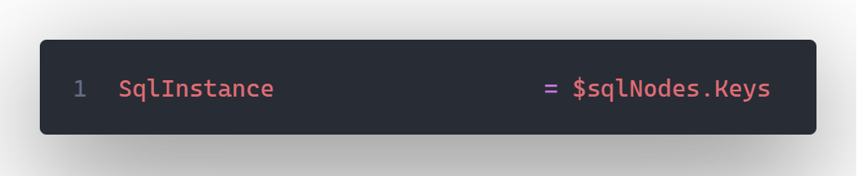
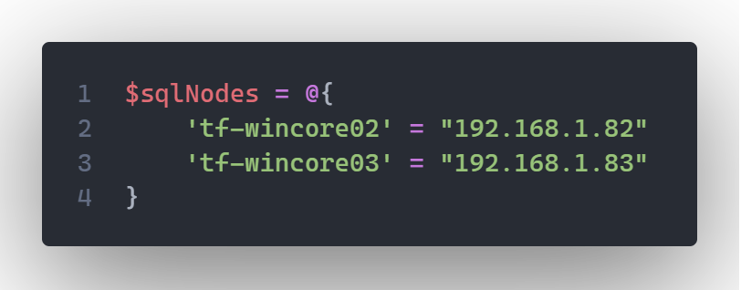
Install SQL Server

Slide 57
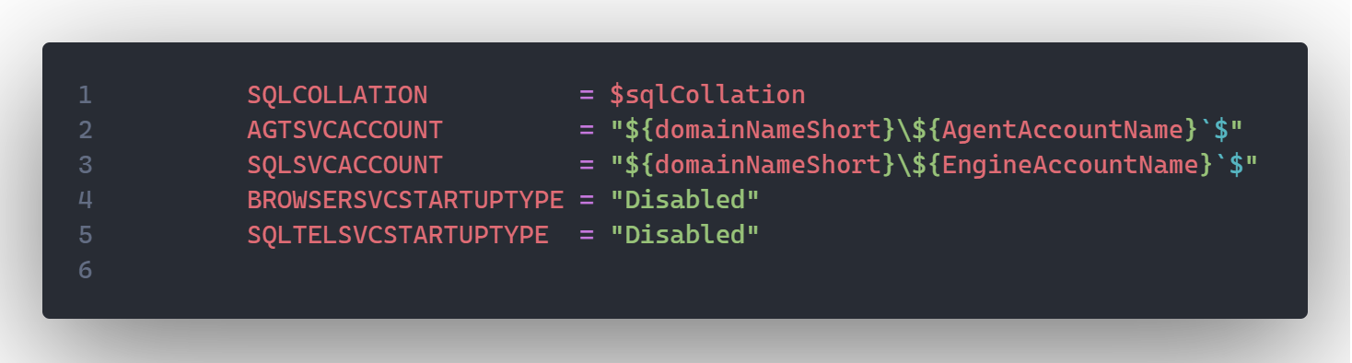
Install SQL Server

Slide 58
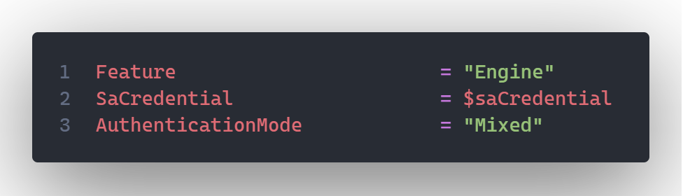
Install SQL Server

Slide 59
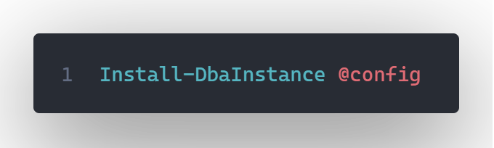
Install SQL Server

Slide 60
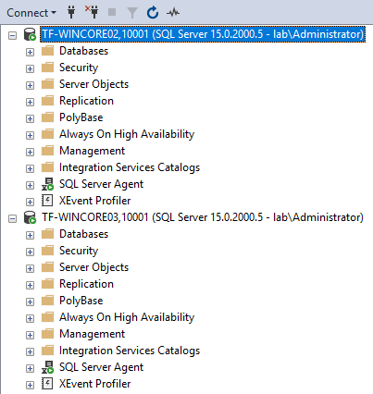
Install SQL Server

Slide 61
Install SQL Server on the 2 nodes
Configure SQL Server instances
Perform hardening (NTFS permissions, revoke connect to guest, etc.)
Install Ola Hallengren’s Maintenance Solution
Install WhoIsActive
Create SQL Agent Jobs and Schedules
Create a new TestDB database
Create an Availability Group
Create an Availability Group Listener
Verify SPNs

Slide 62
SQL Instance Configuration
sp_configure
Max Memory
Add 3226 TF

Slide 63
SQL Instance Configuration
Rename and disable SA
Configure model db
Create a utility database – DBA

Slide 64
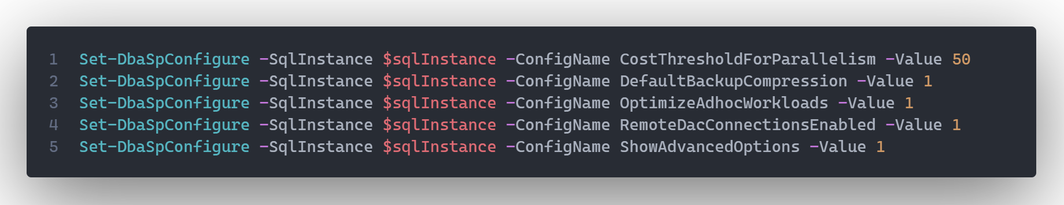
SQL Instance Configuration

Slide 65
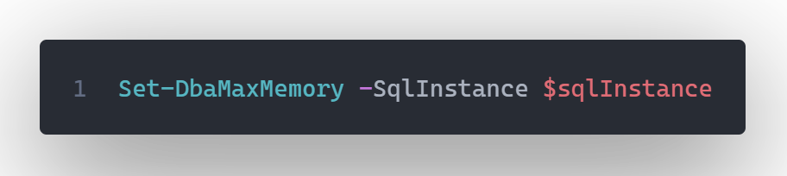
SQL Instance Configuration

Slide 66
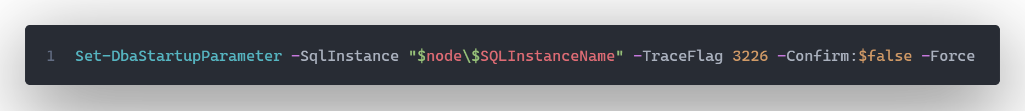
SQL Instance Configuration

Slide 67
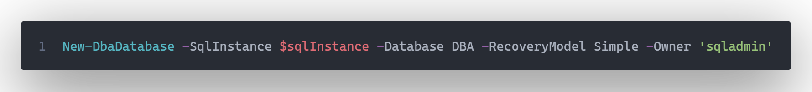
SQL Instance Configuration

Slide 68
Install SQL Server on the 2 nodes
Configure SQL Server instances
Perform hardening (NTFS permissions, revoke connect to guest, etc.)
Install Ola Hallengren’s Maintenance Solution
Install WhoIsActive
Create SQL Agent Jobs and Schedules
Create a new TestDB database
Create an Availability Group
Create an Availability Group Listener
Verify SPNs

Slide 69
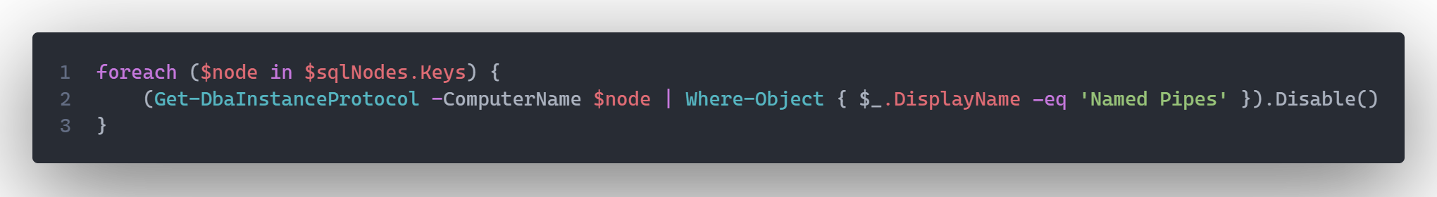
SQL Instance Configuration

Slide 70
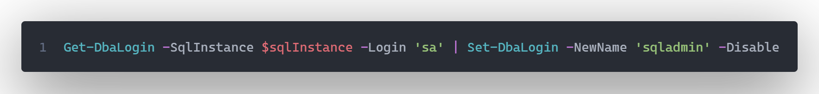
SQL Instance Configuration

Slide 71
Install SQL Server on the 2 nodes
Configure SQL Server instances
Perform hardening (NTFS permissions, revoke connect to guest, etc.)
Install Ola Hallengren’s Maintenance Solution
Install WhoIsActive
Create SQL Agent Jobs and Schedules
Create a new TestDB database
Create an Availability Group
Create an Availability Group Listener
Verify SPNs

Slide 72
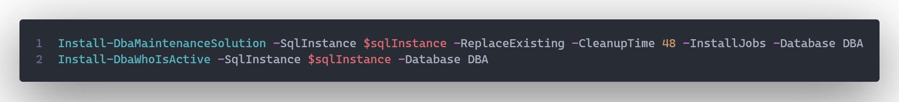
SQL Instance Configuration

Slide 73
Install SQL Server on the 2 nodes
Configure SQL Server instances
Perform hardening (NTFS permissions, revoke connect to guest, etc.)
Install Ola Hallengren’s Maintenance Solution
Install WhoIsActive
Create SQL Agent Jobs and Schedules
Create a new TestDB database
Create an Availability Group
Create an Availability Group Listener
Verify SPNs

Slide 74
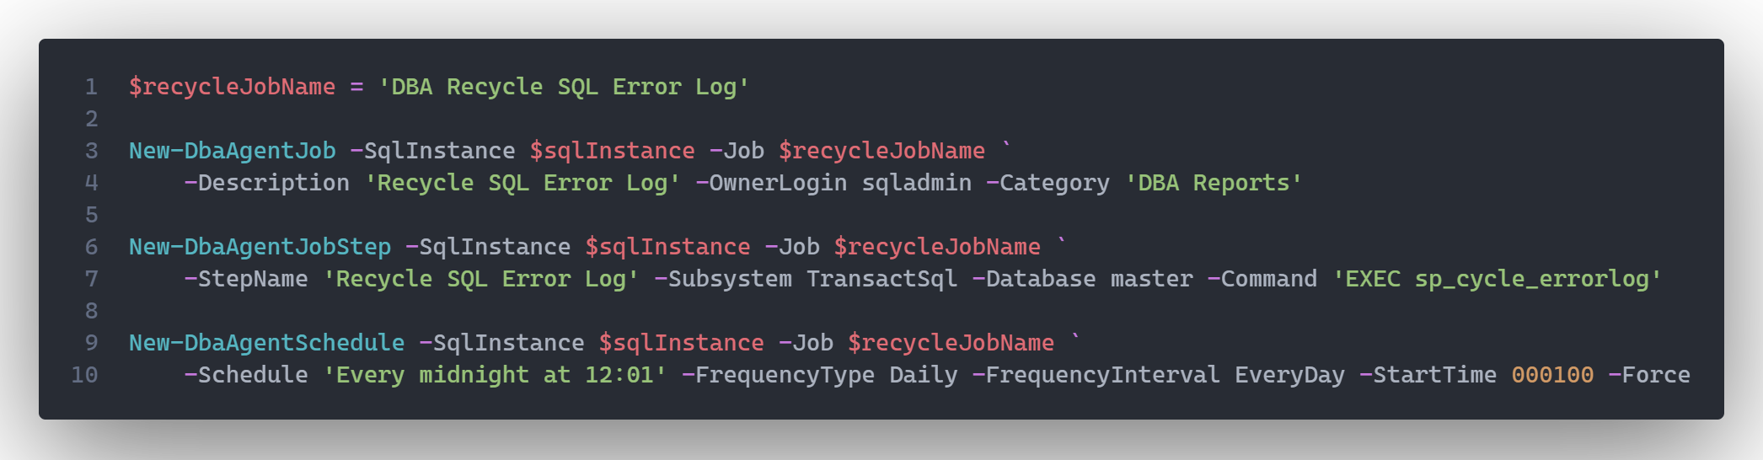
SQL Instance Configuration

Slide 75
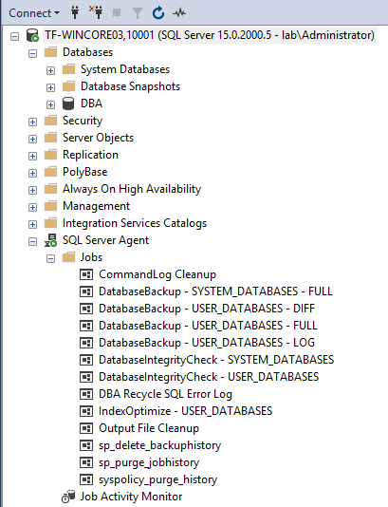
Get-Instances

Slide 76
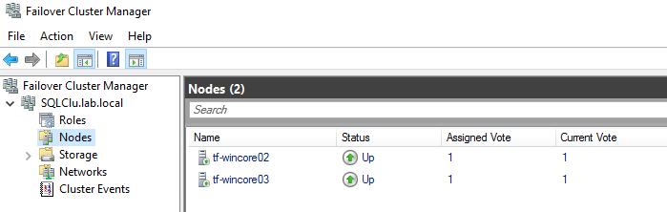
Create WFC

Slide 77
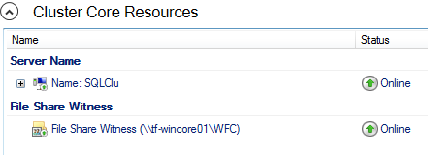
Create WFC

Slide 78
Install SQL Server on the 2 nodes
Configure SQL Server instances
Perform hardening (NTFS permissions, revoke connect to guest, etc.)
Install Ola Hallengren’s Maintenance Solution
Install WhoIsActive
Create SQL Agent Jobs and Schedules
Create a new TestDB database
Create an Availability Group
Create an Availability Group Listener
Verify SPNs

Slide 79
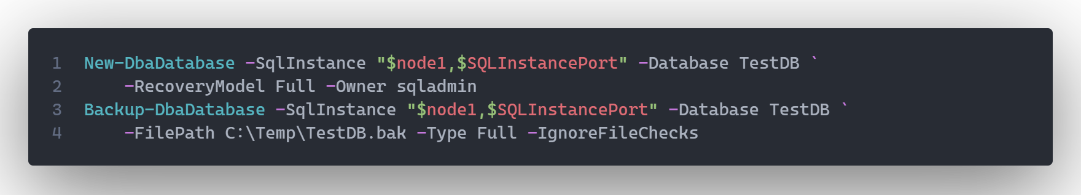
Create Availability Group

Slide 80
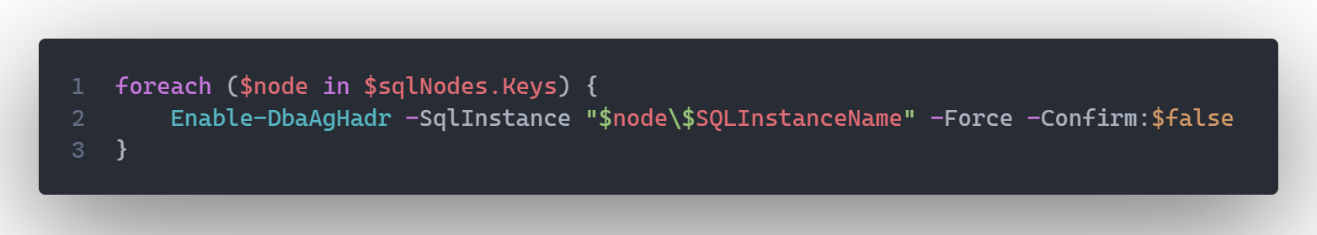
Create Availability Group

Slide 81
Install SQL Server on the 2 nodes
Configure SQL Server instances
Perform hardening (NTFS permissions, revoke connect to guest, etc.)
Install Ola Hallengren’s Maintenance Solution
Install WhoIsActive
Create SQL Agent Jobs and Schedules
Create a new TestDB database
Create an Availability Group
Create an Availability Group Listener
Verify SPNs

Slide 82
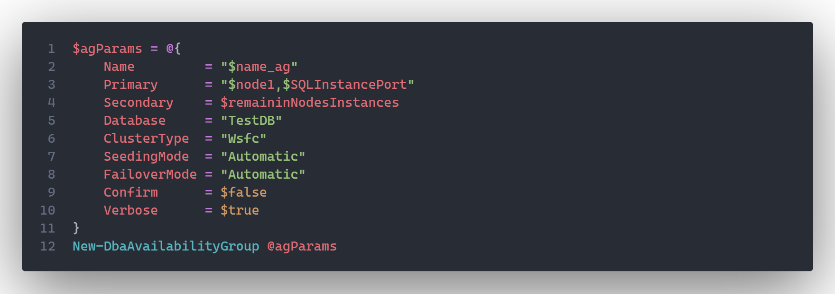
Create Availability Group

Slide 83
Install SQL Server on the 2 nodes
Configure SQL Server instances
Perform hardening (NTFS permissions, revoke connect to guest, etc.)
Install Ola Hallengren’s Maintenance Solution
Install WhoIsActive
Create SQL Agent Jobs and Schedules
Create a new TestDB database
Create an Availability Group
Create an Availability Group Listener
Verify SPNs

Slide 84
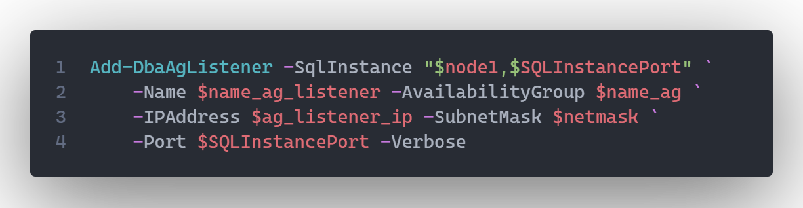
Create Availability Group

Slide 85
Install SQL Server on the 2 nodes
Configure SQL Server instances
Perform hardening (NTFS permissions, revoke connect to guest, etc.)
Install Ola Hallengren’s Maintenance Solution
Install WhoIsActive
Create SQL Agent Jobs and Schedules
Create a new TestDB database
Create an Availability Group
Create an Availability Group Listener
Verify SPNs

Slide 86
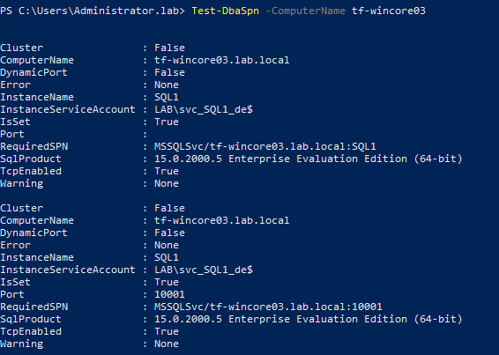
SPNs

Slide 87


Slide 88
Install SQL Server on the 2 nodes
Configure SQL Server instances
Perform hardening (NTFS permissions, revoke connect to guest, etc.)
Install Ola Hallengren’s Maintenance Solution
Install WhoIsActive
Create SQL Agent Jobs and Schedules
Create a new TestDB database
Create an Availability Group
Create an Availability Group Listener
Verify SPNs

Slide 89
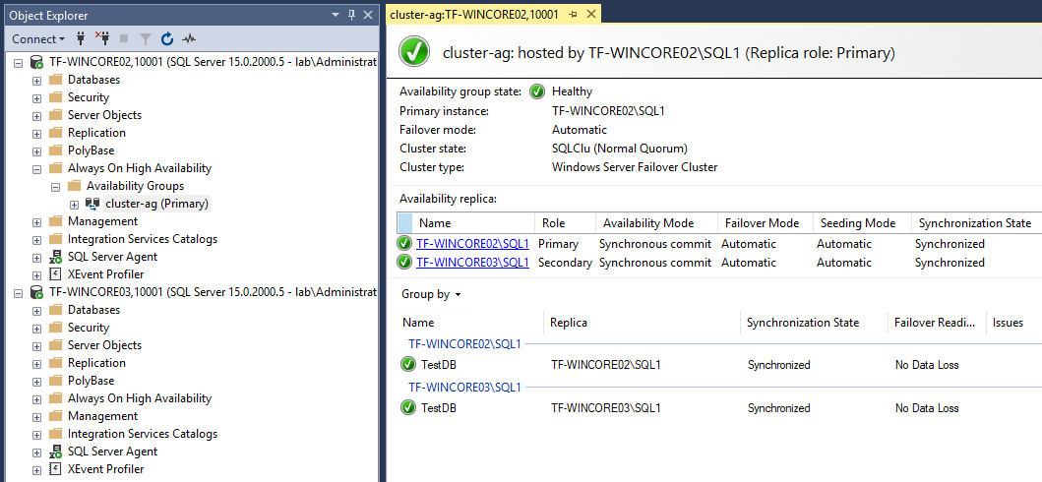

Slide 90
Get-Resources
https://learn.hashicorp.com/
https://www.packer.io/docs
https://www.terraform.io/docs/index.html
https://docs.dbatools.io/
https://dbatools.io/blog/

Slide 91
Thank you!
SQL Community is amazing!

Slide 92
Do you have any questions?
viorel.ciucu@vciconsulting.net
vciconsulting.net
VCI Consulting
THANK YOU

